Slide 1



BOOK A DOCTOR USING MERN

Slide 2
TEAM MEMBERS
Adlin Gracia D – 210121104003
Divya Priya - 210121104014
Christy Titus - 210121104012
Helen - 210121104018

Slide 3
TABLE OF CONTENTS
Introduction
Website architecture
Technologies used
Functional demo

Slide 4
INTRODUCTION
Book a Doctor is a full-stack web application built using the MERN (MongoDB, Express, React, Node.js) stack, designed to simplify the process of booking appointments with doctors. The platform allows users to create accounts, log in, browse a list of available doctors, view doctor profiles with details and specialisations, and schedule appointments. Users can also view their appointment history, manage bookings, and receive notifications or reminders.
The application provides secure access for administrators to manage doctor profiles, appointment schedules, and user interactions. Admins can update doctor information, oversee booking requests, and monitor platform activity, ensuring a smooth and organized experience for both doctors and patients.
This project highlights the potential of the MERN stack to build scalable, responsive, and user-friendly applications that enhance users' healthcare experiences.

Slide 5
TECHNOLOGIES USED
Front End Technology:
React
React-Router
React-Redux
React-Bootstrap
Html
Css
Back End Technology:
Node Js
Express Js
MongoDb
bcrypt

Slide 6
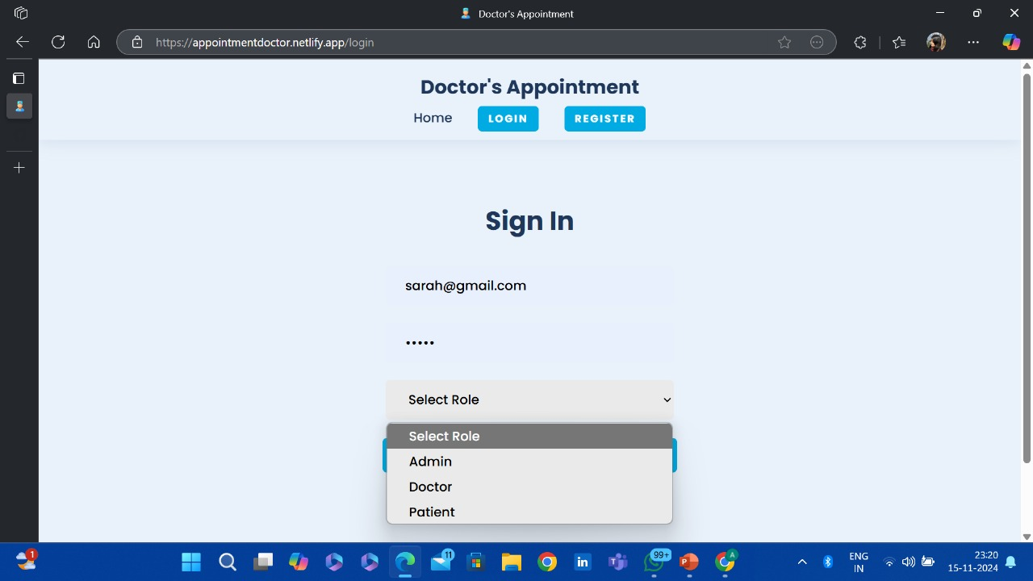
SIGNIN PAGE

Slide 7
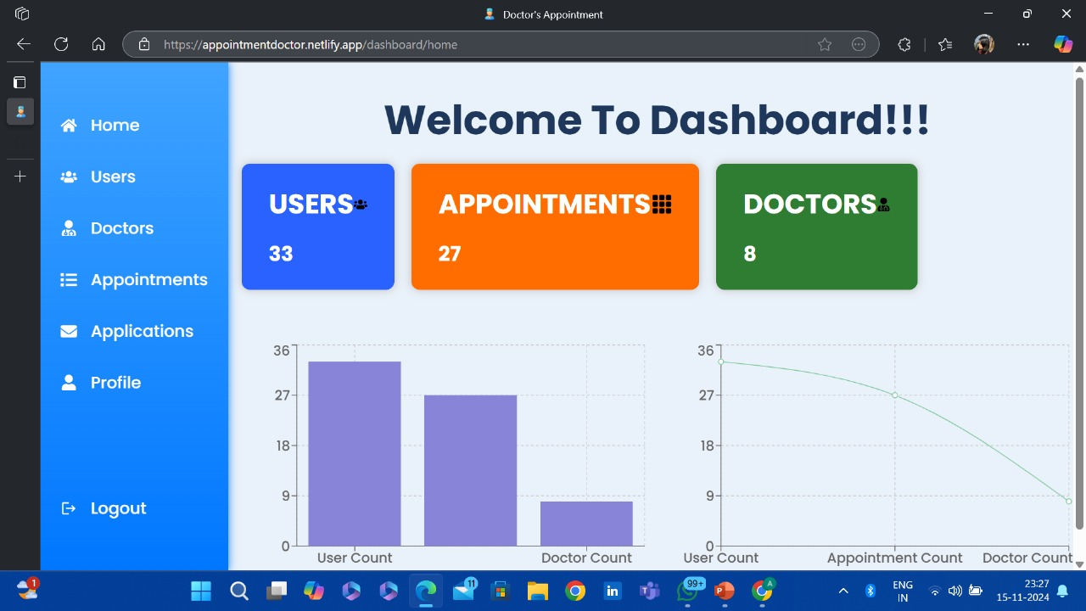
ADMIN PAGE

Slide 8
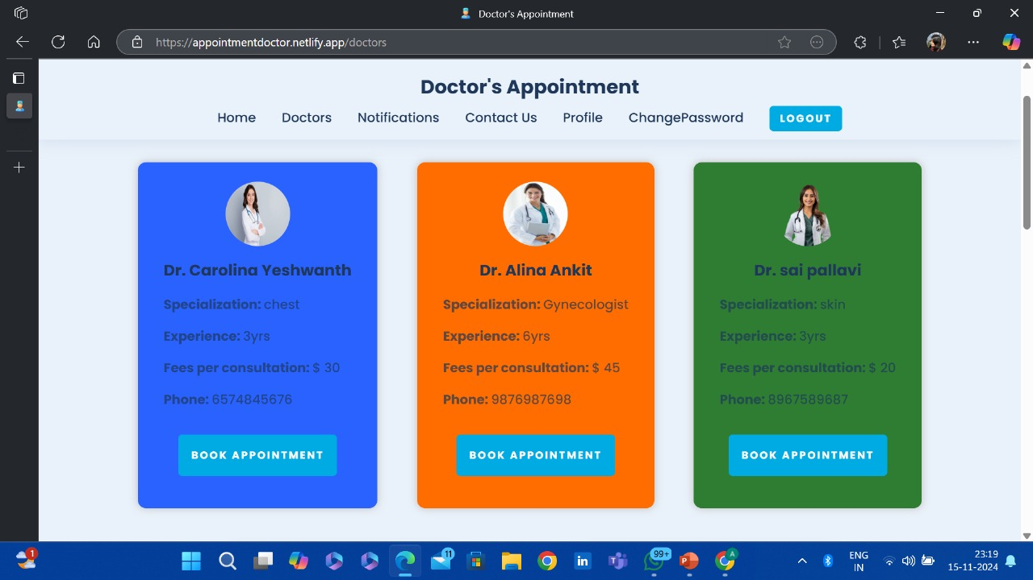
APPOINTMENT PORTAL

Slide 9
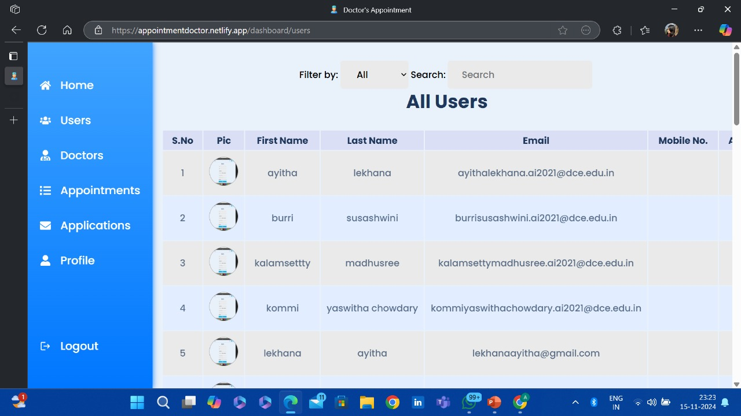
USER PAGE

Slide 10
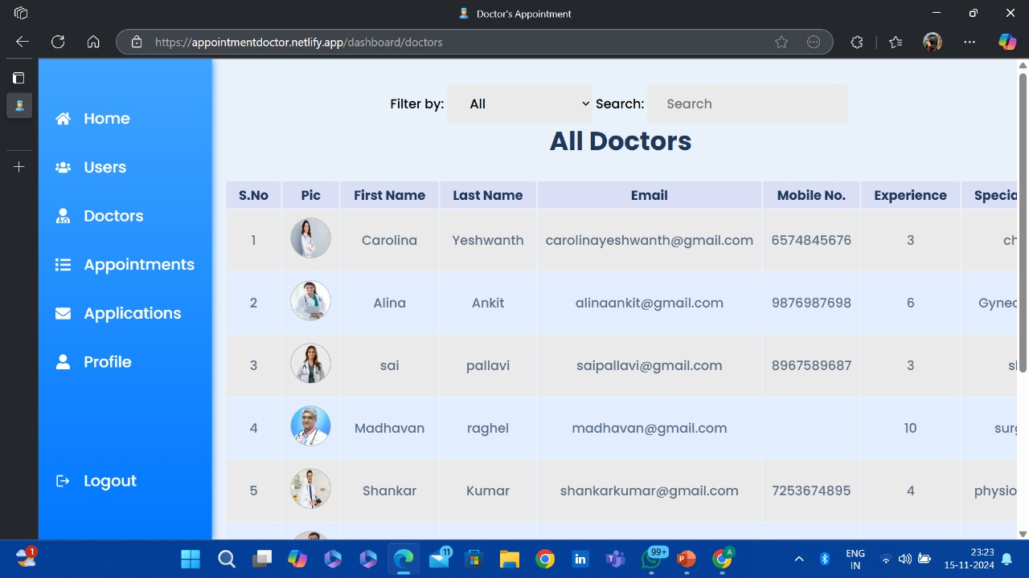
DOCTORS LIST

Slide 11
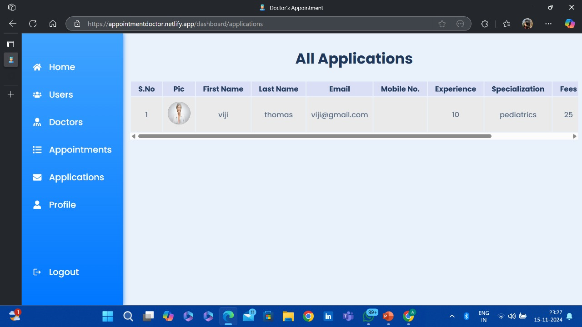
DOCTORS APPLICATIONS

